Slide 1

Registration and Dimensionality Reduction Algorithms for the Analysis of Drosophila Embryogenesis Images
Carmeline Dsilva, Bomyi Lim, Amit Singer
Stanislav Shvartsman, and Yannis Kevrekidis
AIChE Annual Conference
18 November 2014

Slide 2
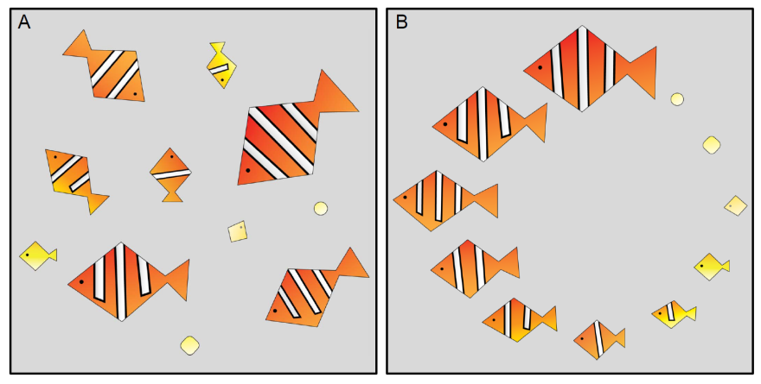
Reconstructing Dynamics from Snapshots
Two types of data collection schemes
when studying developmental dynamics
Longitudinal: Developmental trajectory of a single organism is monitored over time
Cross-sectional: Samples from many organisms are collected; each organism contributes only a single snapshot from the developmental process
A caricature of ordering cross-sectional data.
(Left) Fish, each in a different stage of development.
(Right) Fish, now registered and temporally ordered.

Slide 3
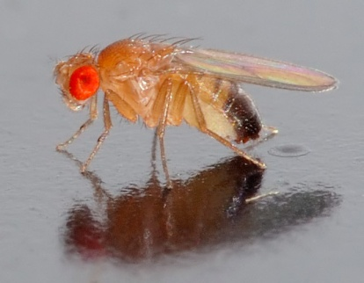
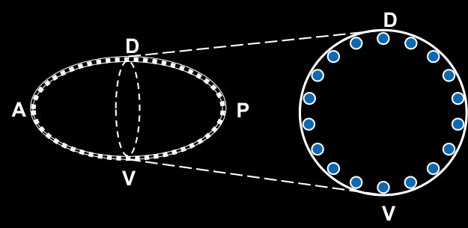
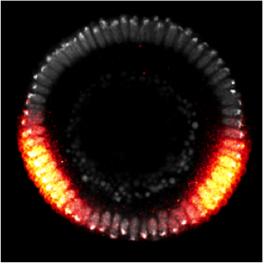
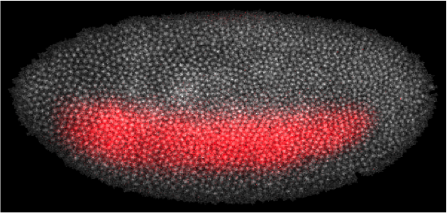
Dynamics of Drosophila Embryogenesis
Drosophila melanogaster (common fruit fly): model organism in developmental biology
We will look at optical sections
perpendicular to the long axis of the embryo

Slide 4
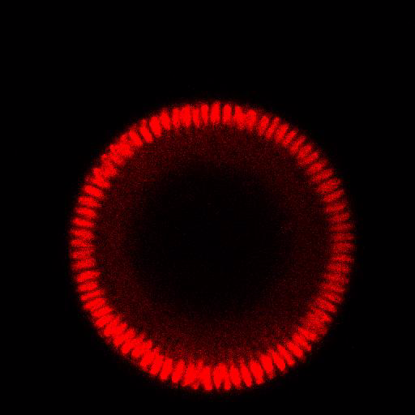
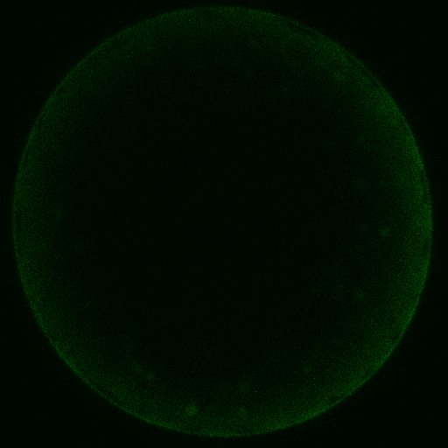
Changes in morphology and changes in distribution of chemical factors
A small number of variables
can be tracked in real time

Slide 5
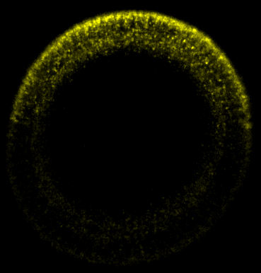
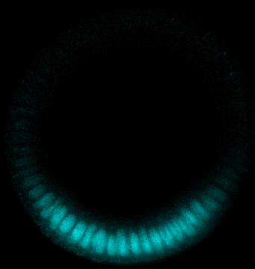
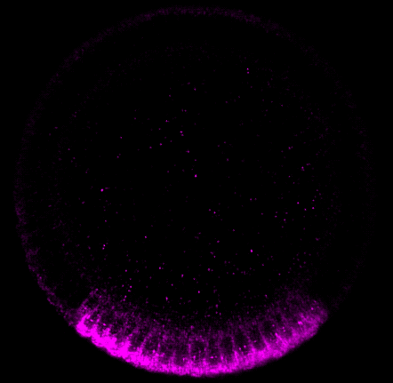
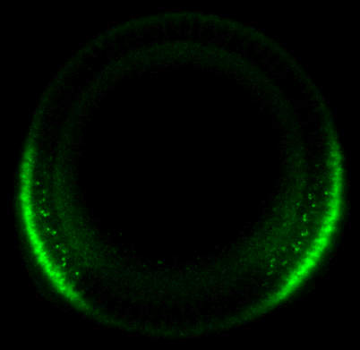
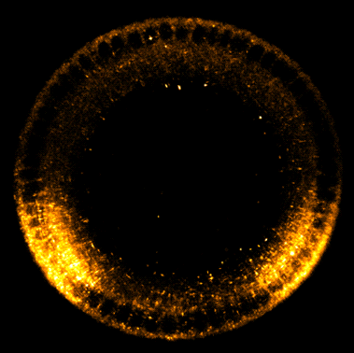
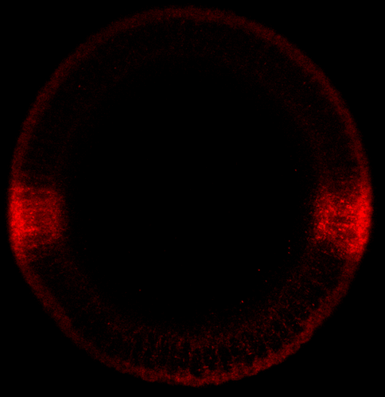
System is patterned by many chemical factors
Dl
dpp
Twi
sna
sog
rho
ind
Dozens of species, in different patterns

Slide 6
Microfluidics for imaging
Chung, Kim, et al. Nature Methods, 2011

Slide 7

Example Data
Live Imaging
One channel
Orientation and time is known
Fixed Images
Several channels
Orientation and time is unknown
Want to merge images to obtain a complete spatiotemporal picture of development

Slide 8
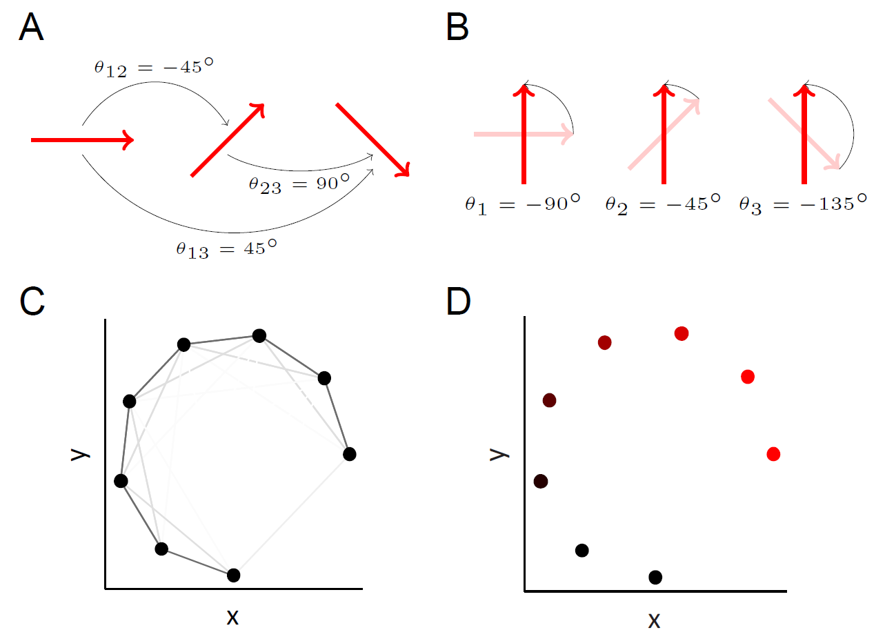
Registration and Ordering of Fixed Images
Algorithm
Compute pairwise alignments θ_{ij}
Compute pairwise distances d_{ij}
Calculate kernel matrix W, with
W_{ij}=exp(-d²_{ij}/ε)
Calculate matrix A = D⁻¹W
Calculate matrix S = e^{iθij} A_{ij}
Top eigenvector of S gives estimated rotations
Second eigenvector of S gives embedding coordinate/order
Rotational orientations and relative times are unknown
Register and order using vector diffusion maps (VDM)
First VDM coordinate will parameterize
developmental time
Singer and Wu, Commun Pure Appl Math, 2012

Slide 9
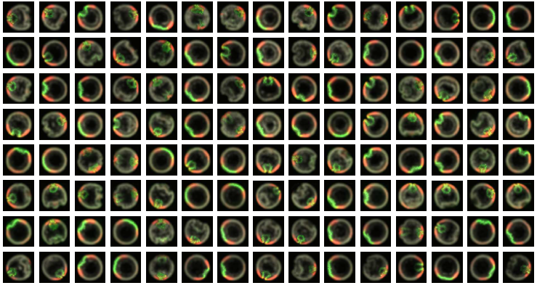
Registering and Ordering Fixed Images
Fixed images with three channels.
Each image is from a different embryo
at a different and unknown developmental time.

Slide 10
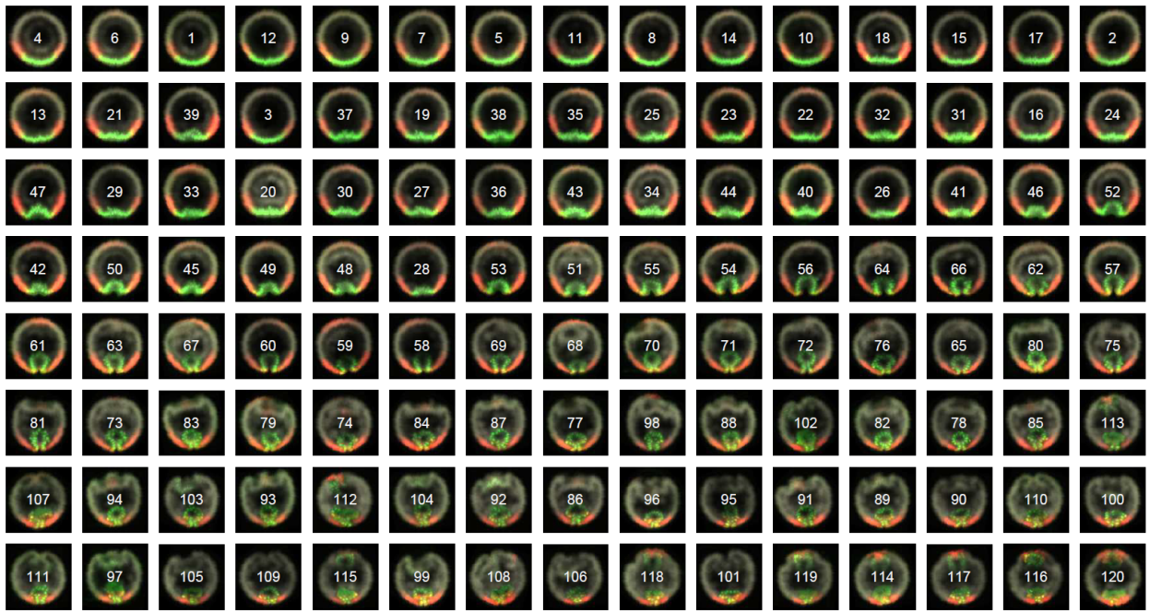
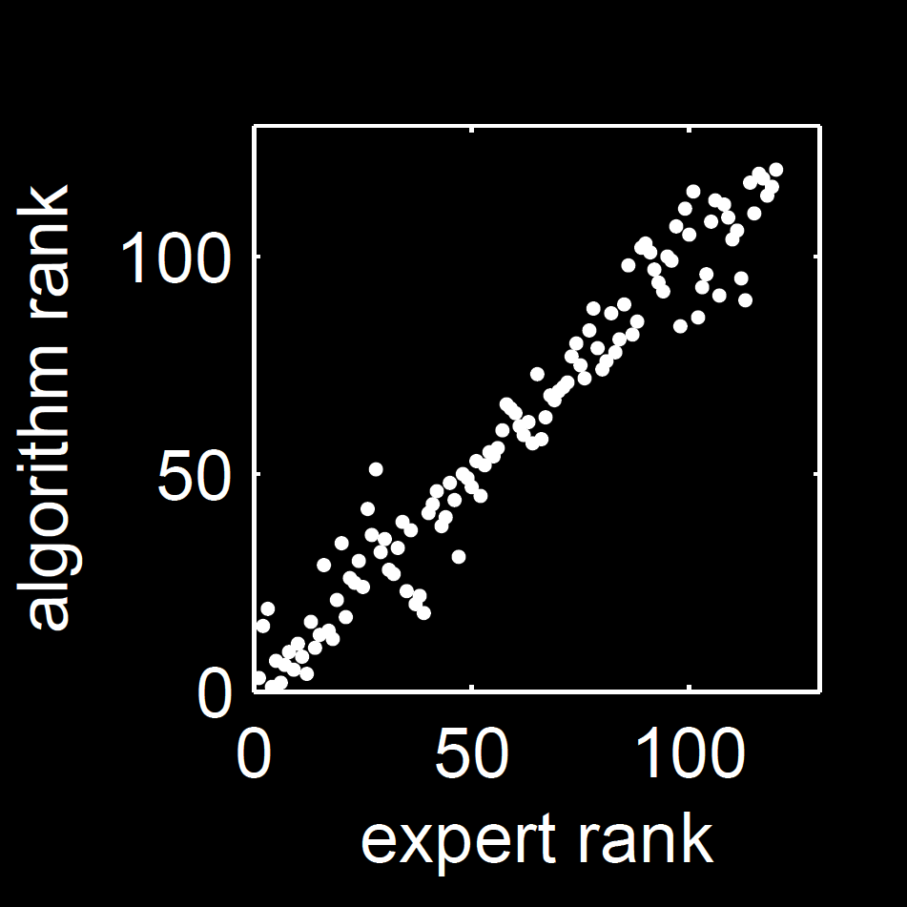
Registering and Ordering Fixed Images
VDM ordering is consistent
with the manual ordering from an embryologist
We can compute a “representative” developmental trajectory

Slide 11
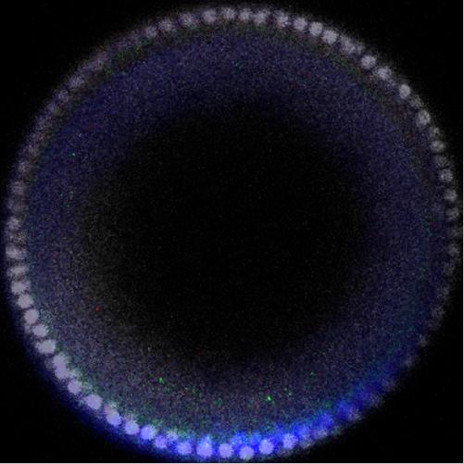
Merging Live and Fixed Images
Need real-time information (not only relative orders) for many applications (e.g., kinetics)
Want to merge real-time single-channel live imaging data with the multiple-channel fixed data to obtain a real-time information for multiple channels.
Goal: estimate times of fixed images from live imaging
+
=

Slide 12
Reduce Image Dimension using PCA
Registered image
(10000 pixels)
Compute PCA modes from live imaging
Project image
onto PCA modes
PC₁ = -1191
PC₂ = -843
PC₃ = -272
PC₄ = -693
PC₅ = 1000

Slide 13
Linear Model for Time Prediction
Fit linear model
time = β₀ + β₁PC₁+ β ₂PC₂ + β ₃PC₃ + β ₄PC₄ + β ₅PC₅
PC are the projection coefficients
Find β₀,…,β₅ using live imaging as training data
time =
β₀ + β₁PC₁+ β ₂PC₂ + β ₃PC₃ + β ₄PC₄ + β ₅PC₅
= 12.37 min
Predict time (with error bars) using regression model
New fixed image

Slide 14
Interpolating Signals
1. Select frame from movie
(60 minutes)
4. Compute average over fixed images
(cross-dissolve)
2. Find fixed images which have similar times
5. Combine average fixed image with movie frame
3. Extract channels from fixed images

Slide 15
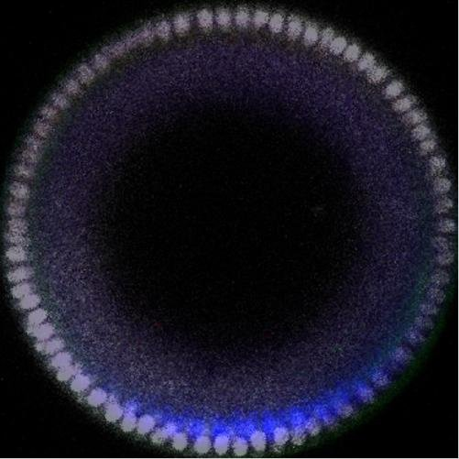
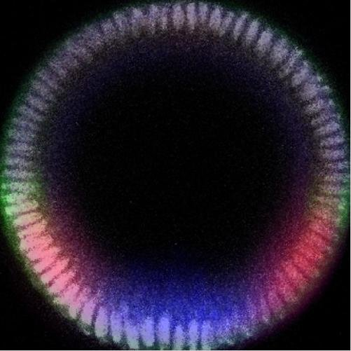
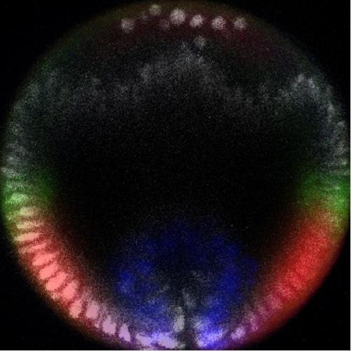
Errors in Merging Data
Signal is not localized to nuclei
This is (biologically) incorrect
Current work: local warping of images so that nuclear signals overlap

Slide 16
Local Warping
Use optical flow to determine approximate shifts for pixels
Use RBF to interpolate shifts to new pixels
Does not match movie frame
Matches movie frame
Frame from movie
Fixed image
with optical flow field
Warped fixed image
Current work: extracting contours for more accurate warping

Slide 17
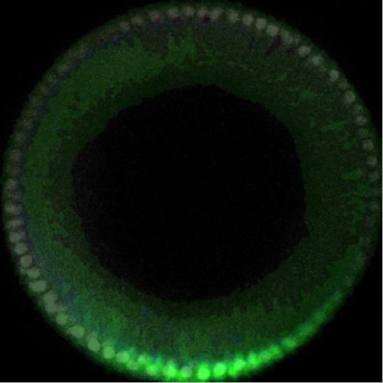
Multichannel Movie
Gray nuclei are from a live imaging study of a single embryo,
colored signals are from multiple fixed embryos, locally warped to align nuclear signals

Slide 18


Conclusions and Future Work
We can merge live and fixed imaging data to obtain a spatiotemporal profile of many genes and proteins
Future work involves
Merging and assimilating lateral images
Improved image warping
Improved time estimation using kernel methods

